Slide 1
Problem Solving & Competition Resources
MathsMeet Conference 2019
Rich and Productive Classrooms
Dr John West

Slide 2
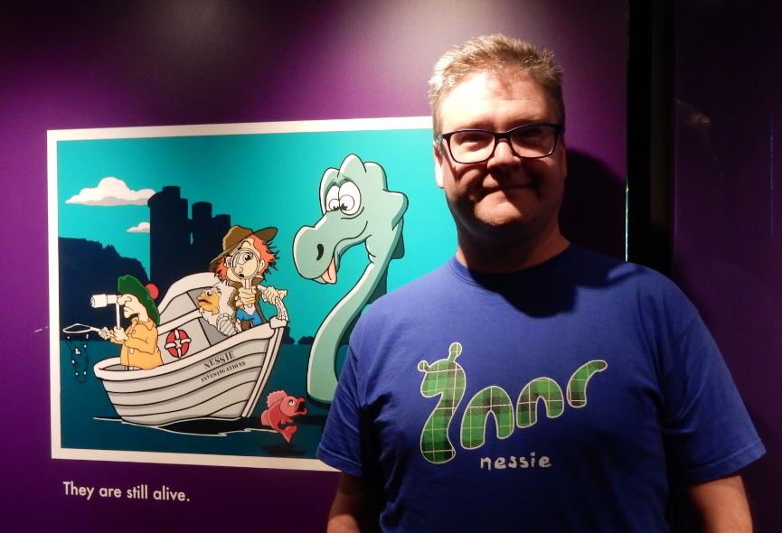
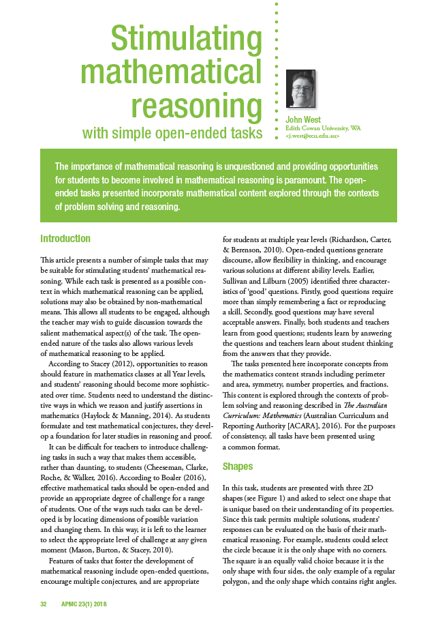
Dr John West
Lecturer in Mathematics Education (ECU)
President, Mathematical Association of Western Australia
Editor, Australian Primary Mathematics Classroom
Previously:
Mathematics teacher, tutor, mentor and G&T coordinator
Lecturer in mathematics education / pedagogy / assessment / special education / research methods (UWA)
Consultant for CEWA, AISWA, GATCA (WA)
Researcher and author

Slide 3
Background
In 2013 a team of ECU researchers were commissioned to report on the status of STEM Education in WA Schools.
The results revealed:
declining performance in STEM subjects against our international competitors;
increasingly negative attitudes towards STEM subjects (internationally; and between Year 4 and Year 8);
declining participation in academically demanding STEM subjects; and
concern about the low proportion of Australian students reaching the advanced achievement benchmarks.

Slide 5
AAMT Singapore Tour (April, 2019)
Notes:
20 teachers from around Australia
We had a full day PL at the NIE – the single teacher education institution in Singapore, where we learned about the structure of the Singapore school system and the curriculum. The theory is virtually identical to what we teach students here.
On Tuesday we visited the Association of Singapore Teachers, which provides PL to between 2000-3000 Singapore teachers daily on an on-demand basis.
All Singapore teachers are entitled to access 100 hours of free PL a year.
We also got to spend 3 days in Singapore schools.
What is it that is so different? Everyone came away with different ideas, but it was clear that there are not huge differences in the classrooms themselves.
Very exam driven; students sit annual exams from Primary 1.
Teachers work incredibly hard and long hours, but only teach around 10-12 hours per week.
There is a great deal of community support; Singapore has a dearth of natural resources.
As a consequence they place great emphasis on professional development.

Slide 6
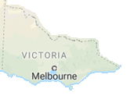
WA / NT context
It’s hard for Victoria or Singapore to comprehend the geographical challenges in WA and the NT. In WA the research revealed:
a strong negative impact of social disadvantage, geolocation and gender on achievement, attitudes and participation (i.e., the gap);
concerns about teacher qualifications and out-of-field teaching; and
the need to ensure fair and even delivery of support across the state (shown to scale)

Slide 7
What does MAWA do?
Student Activities
Teacher PL
Publications & Resources

Slide 8
Student Activities
Student Competitions
MAWA organises a range of student competitions for both primary and secondary schools. These are run on a cost-recovery basis so are very affordable.
Have Sum Fun Face-to-Face (statewide)
Have Sum Fun Online (national; endorsed by AAMT)
We honour member discounts for interstate affiliates
WA Mathematics Problem Solving Program
Originated by Dr Norm Hoffman in 1992
Sponsored by Australian Mathematics Trust (AMT)
First online cohort in 2019. Expanded offerings in 2020.

Slide 9
Have Sum Fun Competition
HSF is an annual competition that uses a quiz-night format
Teams of 6 students race against the clock to solve 4 rounds of 8 problems
There are five divisions: Year 5/6, 7/8, 9/10, and 11/12 Each team can have a maximum of three students from the higher year level
All students receive participation certificates
Schools may enter multiple teams
Currently MAWA organises competitions across WA and would love to include any interstate schools that wish to participate
At the time of publication, the entry fees (per team) were:
MAWA MEMBER/AFFILIATE SCHOOLS: $55 (including GST)
NON-MEMBER SCHOOLS: $68 (including GST)
Register at: https://mawainc.org.au/have-sum-fun-face-to-face/

Slide 10
Have Sum Fun Online
An online version of Have Sum Fun endorsed by AAMT.
HSFOL is an online quiz of NAPLAN-style problems for teams of four.
Separate competitions are run for each year level, and are designed to foster mathematical problem solving for students in Years 3-10 across Australia.
The competition consists of 3 rounds of 10 questions and is conducted over three weeks. Each round is accessible for one week. Teams can log on at any time during the week and have an hour to complete each round.
All team members receive a participation certificate. The top 3 place-getters are shown in the League Table, and there are prize vouchers for each student in these teams: 1st Place = 4 x $25, 2nd Place = 4 x $15, and 3rd Place = 4 x $10.
To register, contact the MAWA office or simply register online.
Entry fees (per team, per term) are:
MAWA MEMBER/AFFILIATE SCHOOLS: $45 (including GST)
NON-MEMBER SCHOOLS: $58 (including GST)

Slide 11
Teacher PL
Combined Primary and Secondary Conference
MAWA’s annual conference will be held at Crown Convention Centre in Perth 18-20 November and each year attracts over 1000 delegates.
Interstate and international contributions are very welcome additions to the conference program. This year’s theme is:

Slide 12
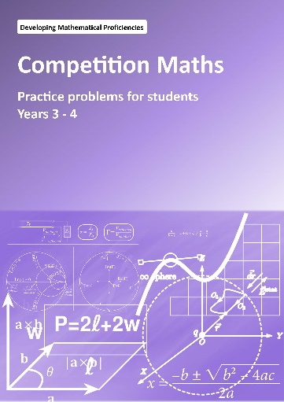
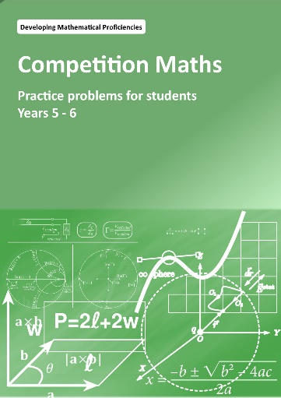
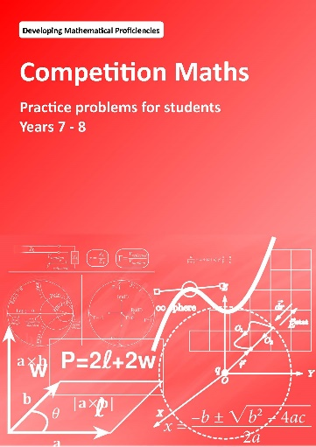
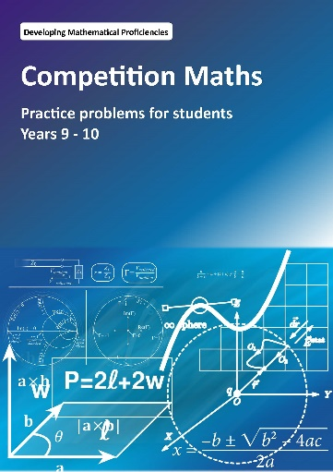
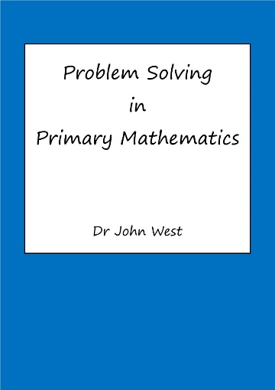
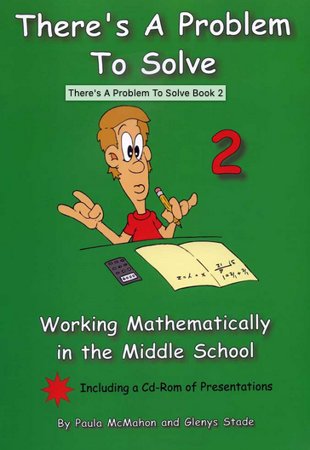
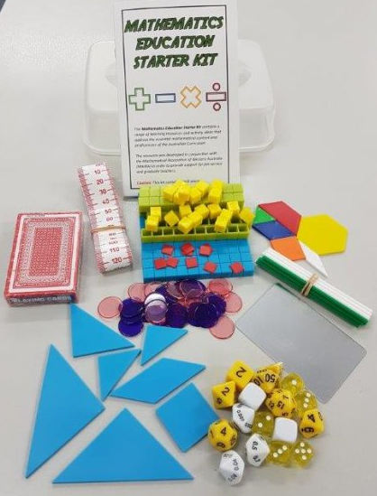
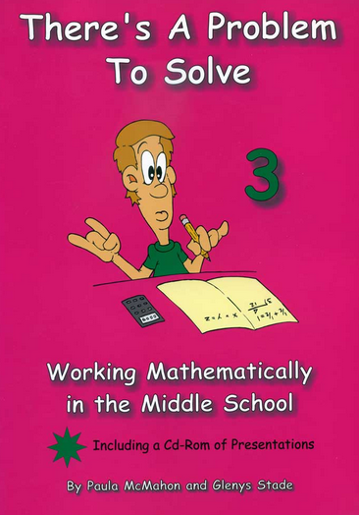

Slide 13
Competition Mathematics Resources
Each Competition Mathematics book contains 128 problems arranged into 16 problem sets
Practice problems are designed to help students prepare for competitions such as the Australian Mathematics Competition (AMC) and Have Sum Fun
A set of four books designed for Year 3/4, 5/6, 7/8 and 9/10 students i.e., Middle Primary/Upper Primary/Junior and Intermediate divisions of AMC
Available as pdf blackline masters
Cost: $50 each (includes limited copying rights) or $150 for 4

Slide 15
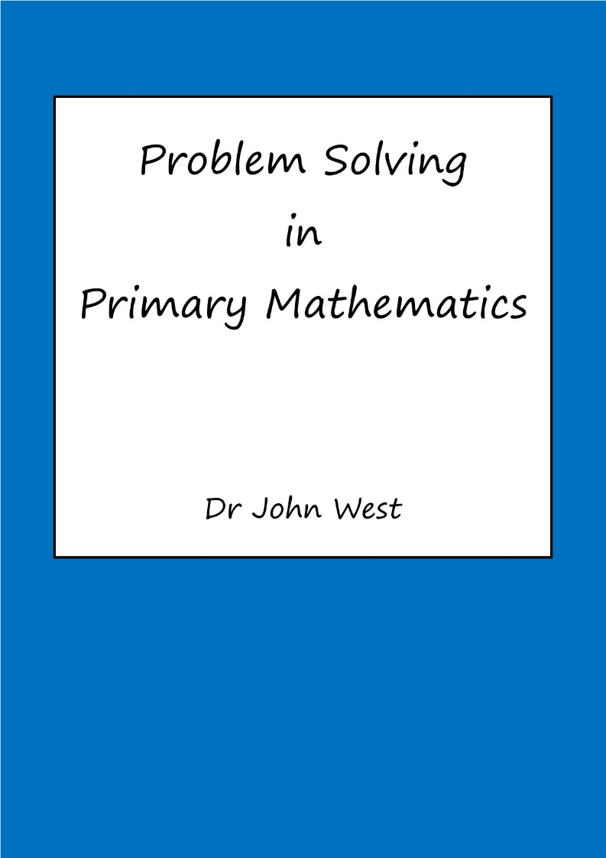
Finding problems
45 worked examples and 200 problems with solutions drawn from across the curriculum
Each chapter focuses on a particular PS strategy
Transfer of learning
Purposefully teach PS strategies.

Slide 16
Resources for Collaborative Problem Solving
Dr Paul Swan & David Dunstan

Slide 17
Professor Peter Sullivan
Extending and enabling prompts provide low-floor, high-ceiling tasks

Slide 18
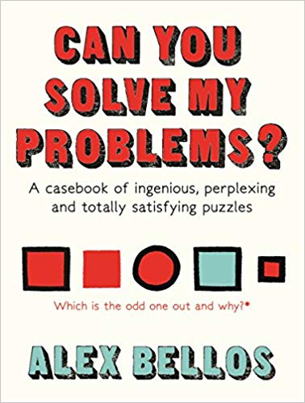
Alex Bellos
Author of Alex’s Adventures in Numberland
Well-written
Easy to read

Slide 19
Kit contains:
39 piece set of Base 10 blocks
- 1 x blue flat (10 x 10 x 1 cm) - 8 x green rods (10 x 1 x 1 cm) - 20 x yellow units (1 x 1 x 1 cm) - 10 x red chips (1 x 1 x 0.1 cm)
2 x blank 6-sided dice
5 x regular 6-sided dice
3 x 10-sided decimal place value dice
1 x tenths die (0.0-0.9)
1 x hundredths die (0.00-0.09)
1 x thousandths die (0.000-0.009)
1 x set of polyhedral dice (7 pieces)
1 x 1 m tape measure
1 x Tangram set (7 pieces)
1 x set of Pattern Blocks (6 pieces)
1 x set of playing cards
1 x plastic mirror
20 x counting sticks (10 x 2 colours)
30 x transparent counters (15 x 2 colours)

Slide 20
Starter Kit Bundles
Starter Kit: $33 (inc. GST)
Kit + 1 book: $40 (inc. GST)
Kit + 2 books: $50 (inc. GST)

Slide 21
ACTIVITY SPLASH PAGE

Slide 22
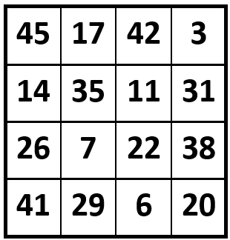
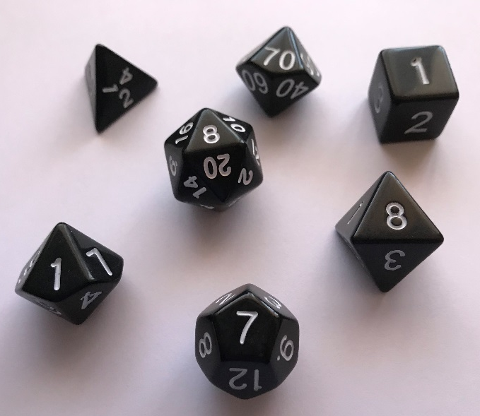
POLYNGO
Materials
A set of polyhedral dice
A BINGO card
Instructions
Roll all of the polyhedral dice.
Use some (or all) of the numbers and the four operations to make numbers on the BINGO card.
The winner is the first player to make all of the numbers in a row, column or diagonal of their card. They need to record their calculations.

Slide 23
POLYNGO
Materials
A set of polyhedral dice
A BINGO card
Instructions
Roll all of the polyhedral dice.
Use some (or all) of the numbers and the four operations to make numbers on the BINGO card.
The winner is the first player to make all of the numbers in a row, column or diagonal of their card. They need to record their calculations.
7 – 1 = 6
8 + 8 + 7 – 1 = 22
8 + 2 + 1 = 11
(8 + 8) x 2 – 1 = 31

Slide 24
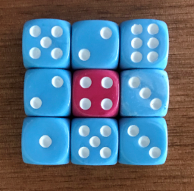
NOGGLE
Materials
9 dice
Instructions
Noggle is a number game that works the same way as the word game with the similar name. ☺
Roll the 9 dice and arrange them as a 3 x 3 array.
Players use some or all of the numbers and the four operations (i.e. +, -, x and ÷) to get as close to an agreed target (e.g. 50) as possible.
The first player to reach the target number exactly scores 10 points. If neither player reaches the target, the player who is closest receives 10 points minus the number they are away from the target.

Slide 25
POWERBALL NOGGLE
Materials
9 dice
Instructions
Noggle is a number game that works the same way as the word game with the similar name. ☺
Roll the 9 dice and arrange them as a 3 x 3 array.
Players use some or all of the numbers and the four operations (i.e. +, -, x and ÷) to get as close to an agreed target (e.g. 50) as possible.
In this variation, players must use the number on the central die. Hint: Use a different colour die so players cannot simply move any number to the centre.

Slide 26
Chicken Nugget Problem
The chicken nugget problem caused mathematicians a real stomach ache until they worked out that there is a maximum number of nuggets that cannot be purchased in a single transaction!
Say nuggets can only be bought in packs of 4 and/or 7.
What is the largest number it is impossible to buy?

Slide 27
Chicken Nugget Problem
The chicken nugget problem caused mathematicians a real stomach ache until they worked out that there is a maximum number of nuggets that cannot be purchased in a single transaction!
Say nuggets can only be bought in packs of 4 and/or 7.
What is the largest number it is impossible to buy?
Clearly it is not possible to purchase 1, 2 or 3 nuggets.
It is also not possible to purchase 5 or 6.
It is possible to purchase 8 nuggets but not 9 or 10.
It is possible to purchase 11 or 12 nuggets, but not 13.
It is possible to purchase 14 nuggets, but not 15.
It is possible to purchase 16 nuggets, but not 17.
It is possible to purchase 18, 19, 20 or 21 nuggets…

Slide 28
DISCARD
Equipment
2 x 6‐sided dice
A deck of cards (1s – 12s / A – 9, J, Q K)
Instructions
Each player is dealt 8 cards. The remaining cards are placed on the table as the stock pile. Players take it in turns to roll two six‐sided dice and to match cards from their hand to the numbers rolled in one of the following ways:
1. A single card may be matched to the sum of the two numbers rolled
E.g., if a 6 and a 2 are rolled, then the player can discard an 8.
2. Two cards may be matched to the two numbers rolled on the dice.
E.g., if a 1 and 4 are rolled, the player discards a 1 and a 4.
3. If the player has just one card remaining, they need only match it with
one of the dice. E.g., if a 1 and a 6 are rolled, the player may discard
either a 1 or a 6.
If a player is unable to make a match during their turn, they must draw a card
from the stock pile.
The winner of the game is the first player to discard all of their cards.

Slide 29
Number Thief!
The notorious number thief has struck again!
Three of the digits appear to have been stolen.
So far it seems that the digits that the digits taken have been selected at random.
Instructions Roll three ten-sided dice to determine the three digits that have been stolen.
For example, the missing digits may be 2, 3 and 7.
If two or more dice show the same digit, then roll again.
Mathematicians are worried that other digits might go missing and so are hoping to be able to use the remaining digits to replace all of the numbers from 1 to 20 in case there’s a national number shortage.
?
Example
Since 2 and 3 are missing, we can’t do 3 – 2 = 1 or 3 + 2 = 5.
Fortunately, we can calculate 5 – 4 = 1 and 6 – 1 = 5.

Slide 30
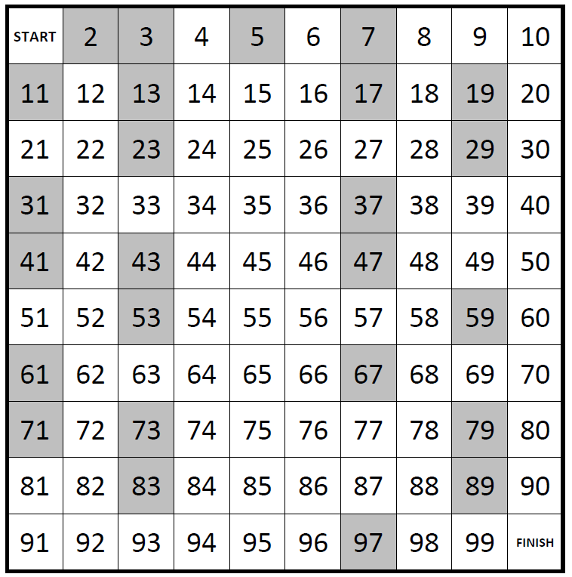
UnPrime
Equipment
• One counter for each player
• 2 x 6-sided dice
Instructions
Players take it in turns to roll the dice, adding or multiplying the two numbers.
They must then move their counter forward that number of spaces.
If they land on a prime number, they must move their counter back to the START!

